Slide 1
Finding Question-Answer Pairs from Online Forums Gao Cong, Long Wang, Chin-Yew Lin, Young-In Song, and Yueheng Sun In Proceedings of the 31st annual international ACM SIGIR conference on Research and development in information retrieval (SIGIR '08) A classification-based approach to question answering in discussion boards Liangjie Hong and Brian D. Davison In Proceedings of the 32nd international ACM SIGIR conference on Research and development in information retrieval (SIGIR '09)
Presented by Polykarpos Thomadakis
CS 834 - Introduction to Information Retrieval
Fall 2017
Old dominion university

Slide 2
Online Forum
A web application for holding discussions and posting user generated content in a specific domain (sports, recreation, techniques etc.)
Contains huge amount of valuable user generated content
Highly desirable to extract this content and reuse it

Slide 3
Applications of Forum Mining
Essential to many QA services
SE instant answers
QA search systems
Community-based Question Answering (CQA)
A natural way to improve forum management
Query question-answer pairs extracted from forums
Question-answer knowledge mined can be used to augment the knowledge base of chatbots

Slide 4
Challenge
Each forum thread usually contains an initiating post and a couple of reply posts
The initiating post usually contains several questions
The asynchronous nature of forum discussion makes it common for multiple participants to pursue multiple questions in parallel
Proposed method consists of two components
Question detection
Answer detection

Slide 5
Question Detection
Harder than it looks:
Questions stated in informal way
In various formats
Question marks and 5W1H question words not adequate
30% do not end with question marks
9% ending with question marks are not questions (e.g. “really?”)
Use labeled sequential patterns (LSPs) to build classifiers and complement the inadequacy of simple rules

Slide 6
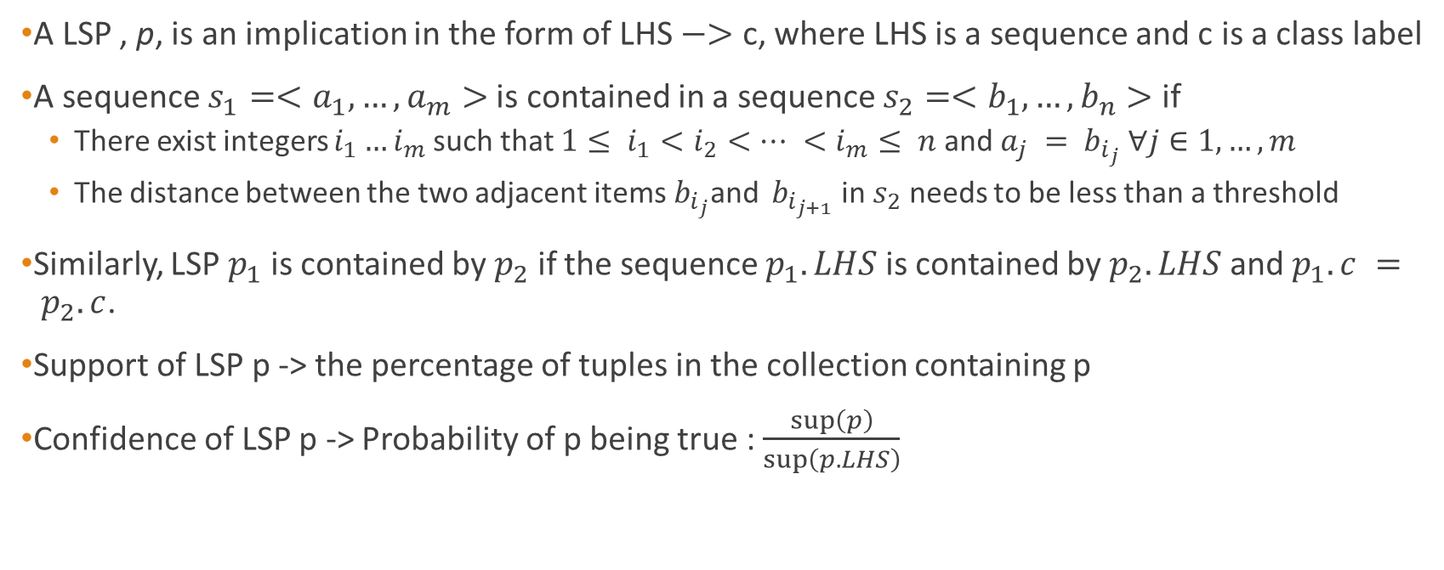
Labeled Sequential Patterns (LSPs)
A LSP , p, is an implication in the form of LHS $−>$ c, where LHS is a sequence and c is a class label
A sequence $s_{1}=<a_{1},…,a_{m}>$is contained in a sequence $s_{2}=<b_{1},…,b_{n}>$ if
There exist integers $i_{1}…i_{m}$such that $1≤ i_{1}<i_{2}<… <i_{m}≤ n$and $a_{j} = b_{i_{j}}$ $∀j∈1,…,m$
The distance between the two adjacent items${ b}_{i_{j}}$and ${ b}_{i_{j+1}}$ in $s_{2}$ needs to be less than a threshold
Similarly, LSP $p_{1}$ is contained by $p_{2}$ if the sequence $p_{1}.LHS$ is contained by $p_{2}.LHS$ and $p_{1}.c = p_{2}.c$.
Support of LSP p -> the percentage of tuples in the collection containing p
Confidence of LSP p -> Probability of p being true : $\frac{\sup\left(p\right)}{\sup\left(p.LHS\right)}$

Slide 7
Approach
Pre-process each sentence by applying Part-Of-Speech (POS) tagger
Keeping keywords including 5W1H and modal words
Keywords are usually good indicators of questions
POS can reduce the sparseness of words
Mine LSPs by imposing minimum support and confidence threshold
Ensure that discovered patterns are general and are capable of predicting question or non-question sentences
Build a classifier using each LSP as a feature
If a sentence includes a LSP the corresponding features is set to 1

Slide 8
Answer Detection
Difficult because:
Multiple questions and answers may be discussed in parallel interweaved together
One post may contain answers to multiple questions
One question may have multiple replies
Straightforward approach:
Cast answer-finding as a traditional document retrieval problem
Employ ranking methods (e.g. cosine similarity, query likelihood and KL-divergence LM)
Does not consider relationship of candidate answers and forum specific features
Model relationship between candidate answers using a graph-based method
A candidate answer related to a candidate answer with high score, is also likely to be an answer even if it doesn’t have a high score

Slide 9
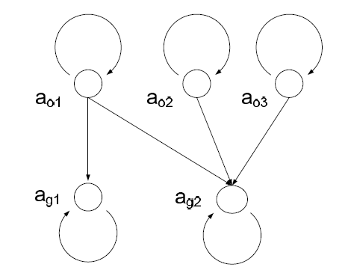
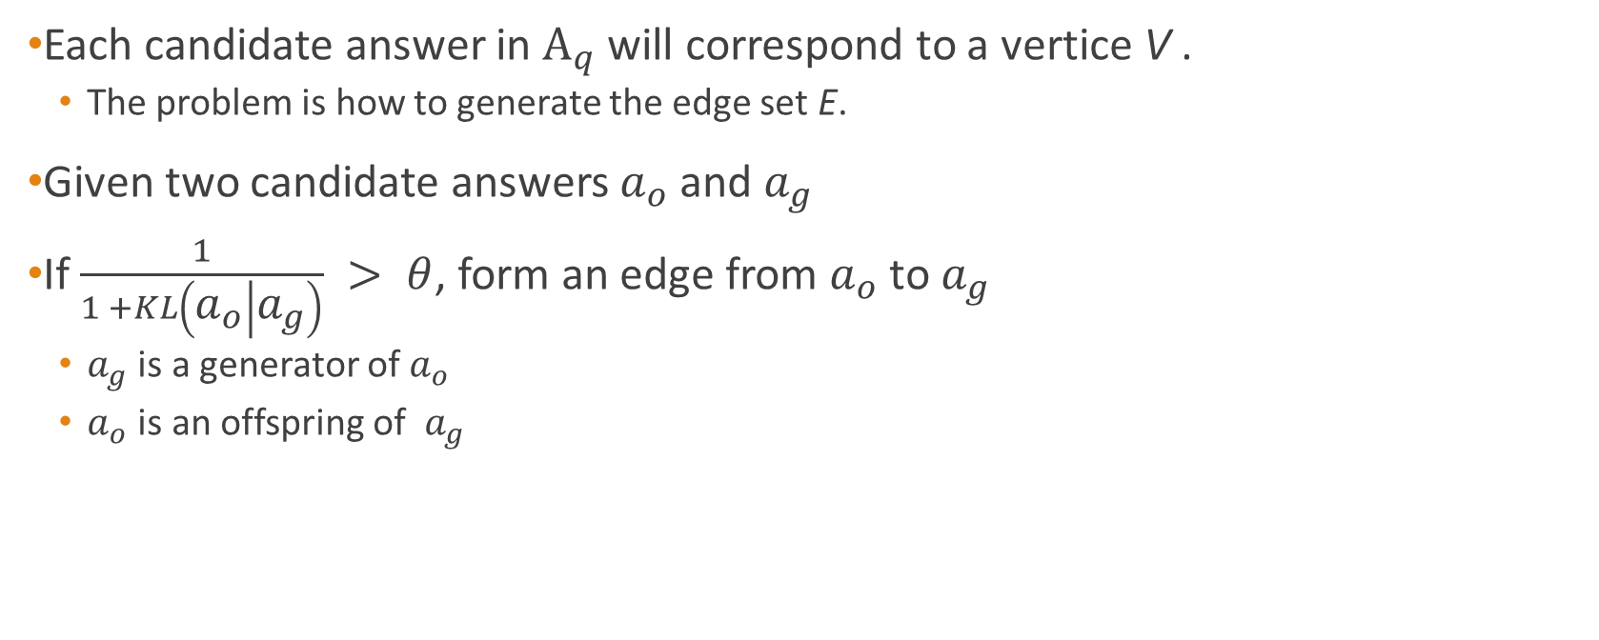
Building Graphs
Each candidate answer in $A_{q}$will correspond to a vertice V .
The problem is how to generate the edge set E.
Given two candidate answers $a_{o}$ and $a_{g}$
If $\frac{1}{1 +KL\left(a_{o} | a_{g}\right)} > θ$, form an edge from $a_{o}$ to $a_{g}$
$a_{g}$ is a generator of $a_{o}$
$a_{o}$ is an offspring of $a_{g}$

Slide 10
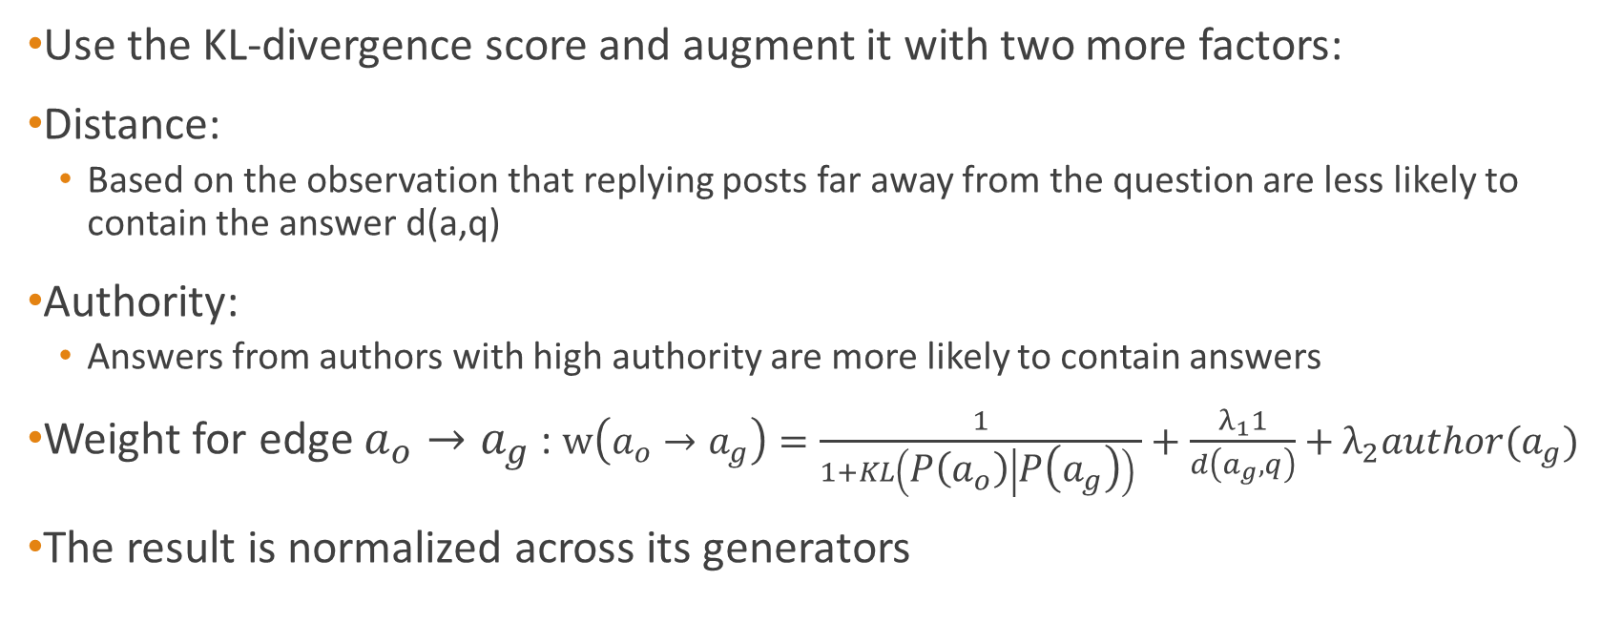
Computing Weights
Use the KL-divergence score and augment it with two more factors:
Distance:
Based on the observation that replying posts far away from the question are less likely to contain the answer d(a,q)
Authority:
Answers from authors with high authority are more likely to contain answers
Weight for edge $a_{o}→a_{g}$ : $w\left(a_{o}→a_{g}\right)=\frac{1}{1+KL\left(P\left(a_{o}\right) | P\left(a_{g}\right)\right) }+\frac{λ_{1}1}{d\left(a_{g},q\right)}+λ_{2}author(a_{g})$
The result is normalized across its generators

Slide 11



Score Propagation
Propagation without initial score:
Compute initial ranking scores using cosine similarity, query likelihood or KL-divergence LM
Compute authority for each candidate answer
The product of authority and initial ranking score is the final score
Propagation with initial score:
Incorporates the initial score between candidate answer and question into propagation

Slide 12
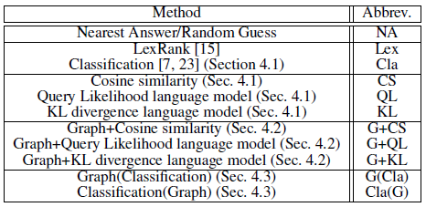
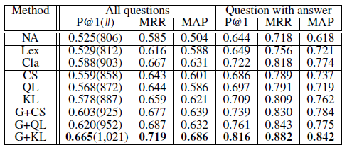
Results

Slide 13
Finding Question-Answer Pairs from Online Forums Gao Cong, Long Wang, Chin-Yew Lin, Young-In Song, and Yueheng Sun In Proceedings of the 31st annual international ACM SIGIR conference on Research and development in information retrieval (SIGIR '08) A classification-based approach to question answering in discussion boards Liangjie Hong and Brian D. Davison In Proceedings of the 32nd international ACM SIGIR conference on Research and development in information retrieval (SIGIR '09)

Slide 14
Same Goal
Retrieve question and potential answers from forums automatically and effectively
Detect question-related threads in an efficient manner
Discover potential answers without analyzing the content of replies
Can this task be treated as a traditional information retrieval problem?

Slide 15
Problem Definition
A post is treated as a single question as a whole
Not focusing on question sentences or paragraphs
Detect whether the first post is a “question post” containing at least one problem needed to be solved.
Consider only the replies that answer directly the first post
Not the ones answering questions in other replies
Include replies providing links to other answers as answer posts

Slide 16
Question Detection
Features used:
Question mark: Sentence ending with a question mark might be a question
5W1H words: Probably used if the sentence is a question
Total number of posts: Empirically many replies indicate a question not well defined or that the topic shifts
Authorship: High quality content generated by highly authoritative authors. Users who usually answer other’s questions
N-grams: Find word relations that are usually seen in questions

Slide 17
Answer Detection
Features used:
The position of the answer post: The answer post usually appears not very close to the bottom
Authorship: Same as before
N-gram: Same as before
Stop Words: See whether the answer contains more detailed and precise words rather than “stop words”
Query Likelihood (Language Model): Calculate the likelihood that a replied post is relevant to the original question post

Slide 18
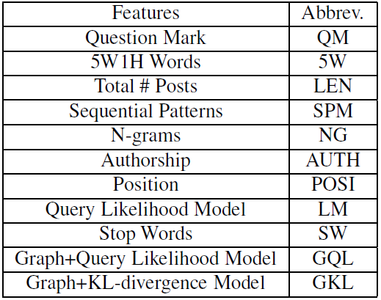
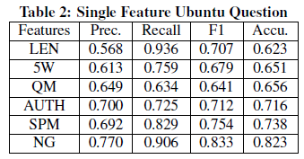
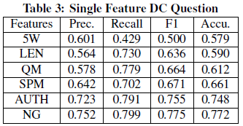
Results: Question Detection (Single features)
N-grams perform better

Slide 19
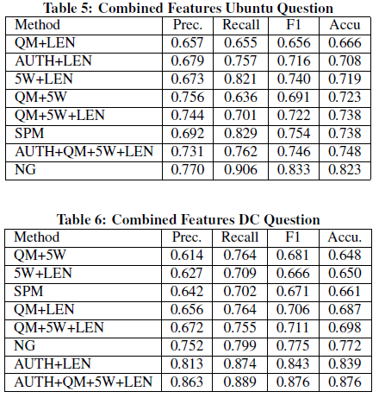
Results: Question Detection (Combined features)
Need only local information
Combinations of features perform considerably better than single features

Slide 20
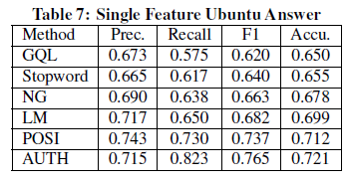
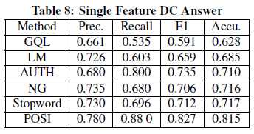
Results: Answer Detection (Single features)
N-grams do not perform that well
Performance using the method from
the 1st paper

Slide 21
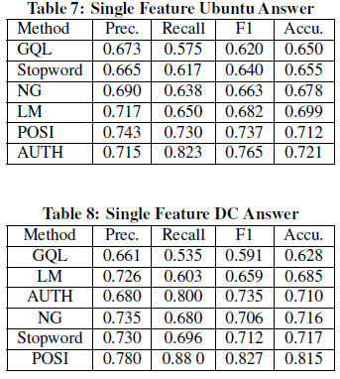
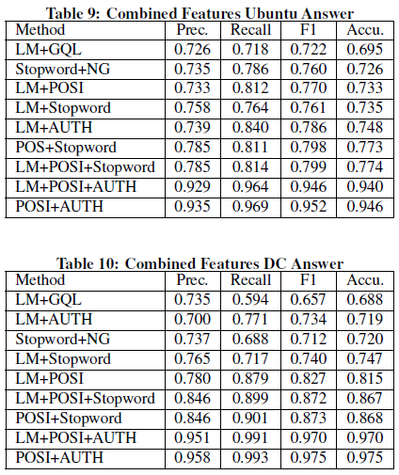
Results: Answer Detection (Combined features)
~ 30% improvement

Slide 22
Why does the 2nd paper cite the 1st?
The 1st paper was the first to address the same problem
The 2nd paper uses some of the methods proposed by the 1st one
They compare their results with those of the 1st paper

